Slide 1

Bluetooth Differential GPS Receiver
and Navigator
Mark Barry
Justin Fields
Jeanne Wu
(Group 6)
Sponsor:
Cal-(IT)²
Mentor:
Paul Blair
ECE 191
Fall 2004

Slide 2
Agenda
October 21, 2004
Review
Statement of Work
Goals / Vision
Gantt Chart

Slide 3
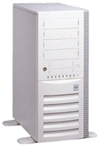
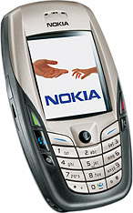
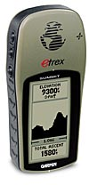

Real-time GPS Corrections
Real-time GPS Corrections
Corrected GPS Data

Slide 4
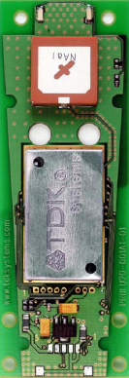
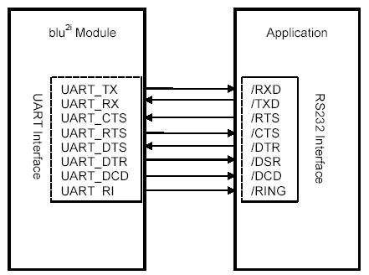
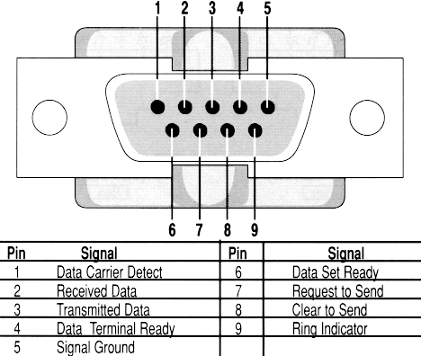
Connection Schematics
Our current problem

Slide 5
Ongoing Problem
The Bluetooth-enabled cell phone is still not able to detect our Blu^{2i} module.
The Blu^{2i} module is not communicating with HyperTerminal.
Efforts
  Tried three different Blu^{2i} modules and four adapters.
  Continuity tested connections.
  Our mentor helped us extensively but still couldn’t figure out what was wrong.

Slide 6
Next Goal
Study the manual for Blu^{2i} module more carefully and try to understand the reason for not being detected.

Slide 7
In the mean-time…
Mark began studying the 8051 micro-controller and figured out how to “capture” and “re-route” incoming serial communications coming from the GPS receiver.
Modified some example C code and incorporated some serial I/O.
Were able to read in GPS data onto the 8051 micro-controller and re-route it back to HyperTerminal.
Were able to read in GPS data onto the 8051 micro-controller and re-route it to the LEDs on the board.

Slide 8
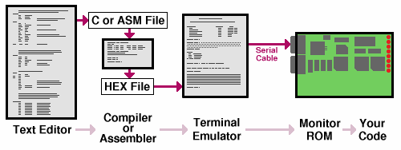
8051 Micro-controller Programming
SDCC (Small Device C Compiler)
Compiles C code for the 8051.
Includes assembler for assembly language programming.
HyperTerminal (in Windows)
Lets us download our program to the 8051.
Lets us control program execution and user input.
Diagram from www.pjrc.com

Slide 9
NMEA (The National Marine Electronics Association)
Format
(Output from the GPS Receiver)
$GPGGA,,,,,,0,00,,,M,,M,,*66
$GPRMC,,V,,,,,,,211004,13.1,E,N*0D
$GPRMB,V,,,,,,,,,,,,A,N*13
$GPGGA,,,,,,0,00,,,M,,M,,*66
$GPGSA,A,1,,,,,,,,,,,,,,,*1E
$GPGSV,3,1,09,04,05,174,00,07,71,215,00,08,53,115,00,11,22,063,00*78
$GPGSV,3,2,09,26,37,292,00,27,33,127,00,28,61,010,00,29,40,281,00*71
$GPGSV,3,3,09,31,85,187,00*41
$GPGLL,,,,,,V,N*64
$GPBOD,,T,,M,,*47
$PGRME,,M,,M,,M*00
$PGRMZ,475,f*02
$HCHDG,24.3,,,13.1,E*2F
$GPRTE,1,1,c,*37

Slide 10
